Slide 1
VOCOMASTER 3000
Created by Alan Kaan Atesoglu & Harry Nelken

Slide 2
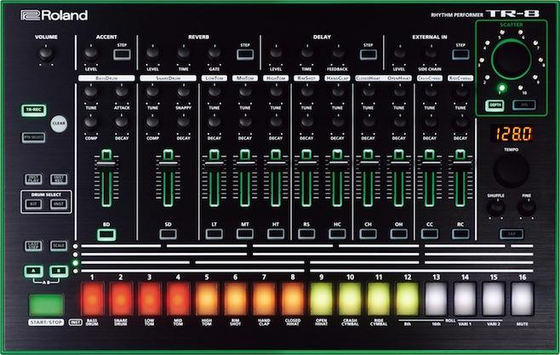
Sequencer? Drum machine? Sampler?
Sequencer: Plays a sequence of sounds in a preset amount of time
Drum Machine: Plays a pre-recorded sound, usually various types of percussion
Sampler: Takes sections of audio to be played or “sampled” in other uses
Together: A sequencer can play a series of percussion and sampled sounds in a never ending loop to create interesting beats or rhythms
Notes:
Harry, quickly cover what all of these are, keeping in mind we are just re-introducting them

Slide 3
Our Application: Major Components
Drum Machine Sequencer
Consistent timing to synchronise behavior across application
Playing multiple sounds without knowing order, or “which” sounds
Possibly multiple at the same time
UI reflective of sound behavior
Audio Sampler
Recording Audio
Fast Playback
Notes:
Kaan, explain a rather general view of the application and how that is equivalent to the previously mentioned machines

Slide 4
Demo
Notes:
Soundless Demo, making a beat, then recording custom audio

Slide 5
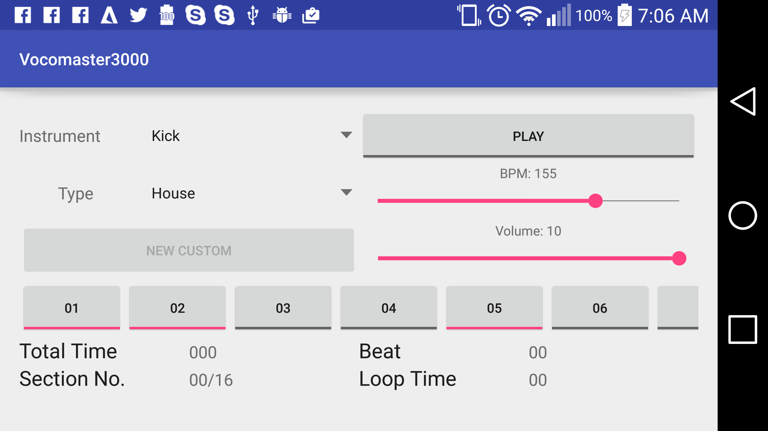
Quick Walkthrough
Notes:
Explain what is here on the screen briefly

Slide 6
Sound Capturing
Android MediaRecorder
Set source
Set output
Set encoding
Start recording!
Writes input directly to file
No custom file names
No save/discard option
Limit on length of recording
Based on common loop lengths!
Notes:
Harry, go into technical depth

Slide 7
All About Timing
Several components needed to be “at the same time”
Clocks
Instrumentation
UI
Solution is Threads
Spawn thread for counting the clock
Must be lightweight to prevent inconsistency
Needs to return thread to UI thread
Returning threads call Instrumentation
Notes:
Kaan, talk about what the problem

Slide 8
Wall of Sounds
AudioManager handles entire application audio, not specific enough
MediaPlayer handles music/audio streams, too involved
SoundPool handles audio resources for applications
Load resources prior to use
Low Latency
Multiple Streams
Example of Usage: Android Game
Notes:
Kaan

Slide 9
Project Challenges
Threading, UI updates
Audio
Time, Tempo, Beats, & Sections
Notes:
Kaan

Slide 10
Project Limitations
Hard coded sounds
Limited Audio Manipulation
Lack of Saving Pattern
Notes:
Harry

Slide 11
References
Android Audio
http://developer.android.com/reference/android/media/SoundPool.html
http://developer.android.com/reference/android/media/AudioManager.html
http://examples.javacodegeeks.com/android/android-soundpool-example/
http://developer.android.com/guide/topics/media/audio-capture.html
Android Threading
http://developer.android.com/training/multiple-threads/communicate-ui.html
Sound Capturing
http://developer.android.com/guide/topics/media/audio-capture.html

